Slide 1
Rock, Paper, Scissors and Driving on the “Right” Side of the Road: An Intro to Game Theory
Kline, Fall 2021: POL 103, module 2

Slide 2
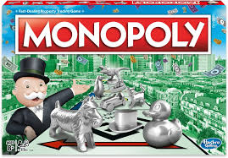
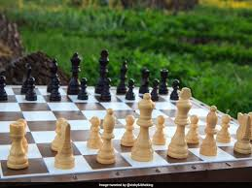

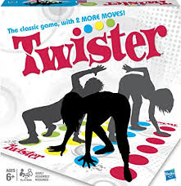
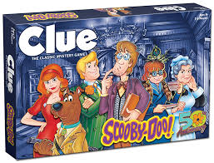
Game Theory

Slide 3
Game Theory: the study of strategic interaction
Game theory is the study of strategic interaction
It requires four components
Players—who can make choices in the game?
Strategies—what choices can the players make in the game?
Payoffs—what costs or benefits do players get when they make certain choices? How happy are they with each potential outcome of the game?
Beliefs—what does each player believe about the choices the other player will make?
Notes:
Assumed to be

Slide 4
Game Theory: the study of strategic interaction
Payoffs
Payoffs represents the costs or benefits that players get when they make certain choices
Because their choices are interdependent –that’s the whole point of game theory after all—each outcome of the game is defined by a combination of choices by the players and is associated with a payoff for each of the players.
You can think of a payoff as how satisfied a player is with an outcome of the game.
This satisfaction can be determined by lots of things status –money, power, status, adoration, schadenfreude, spite, etc., but
We’ll summarize it with a number.
Economists call this utility.
For us, it’s just a number.
People prefer bigger numbers to smaller numbers (these numbers can be negative).
So, given a choice between an option with a payoff of 2 and an option with a payoff of 3, the player will choose the option with a payoff of 3.
Notes:
Assumed to be

Slide 5
Game Theory: the study of strategic interaction
Game theory is the study of strategic interaction
Players are assumed to be
selfish -- meaning they only care about the size of their own payoff
rational – they will always choose a strategy that maximizes their own payoff, assuming that the other player will be doing the same
This means that a player can’t necessarily choose the outcome with the biggest payoff, because they are constrained by the choices of the other player
Players share a common knowledge of rationality. That means that they both assume that the other is selfish and rational and choose accordingly.
Notes:
Assumed to be

Slide 6
Rock, Paper, Scissors
You are probably aware of a game called rock, paper, scissors
Rock beats scissors; scissors beats paper; paper beats rock
Each object defeats exactly one object and is defeated by exactly one object
This is an interesting game, probably why some version of it is widely used across cultures
Why is it interesting?

Slide 7
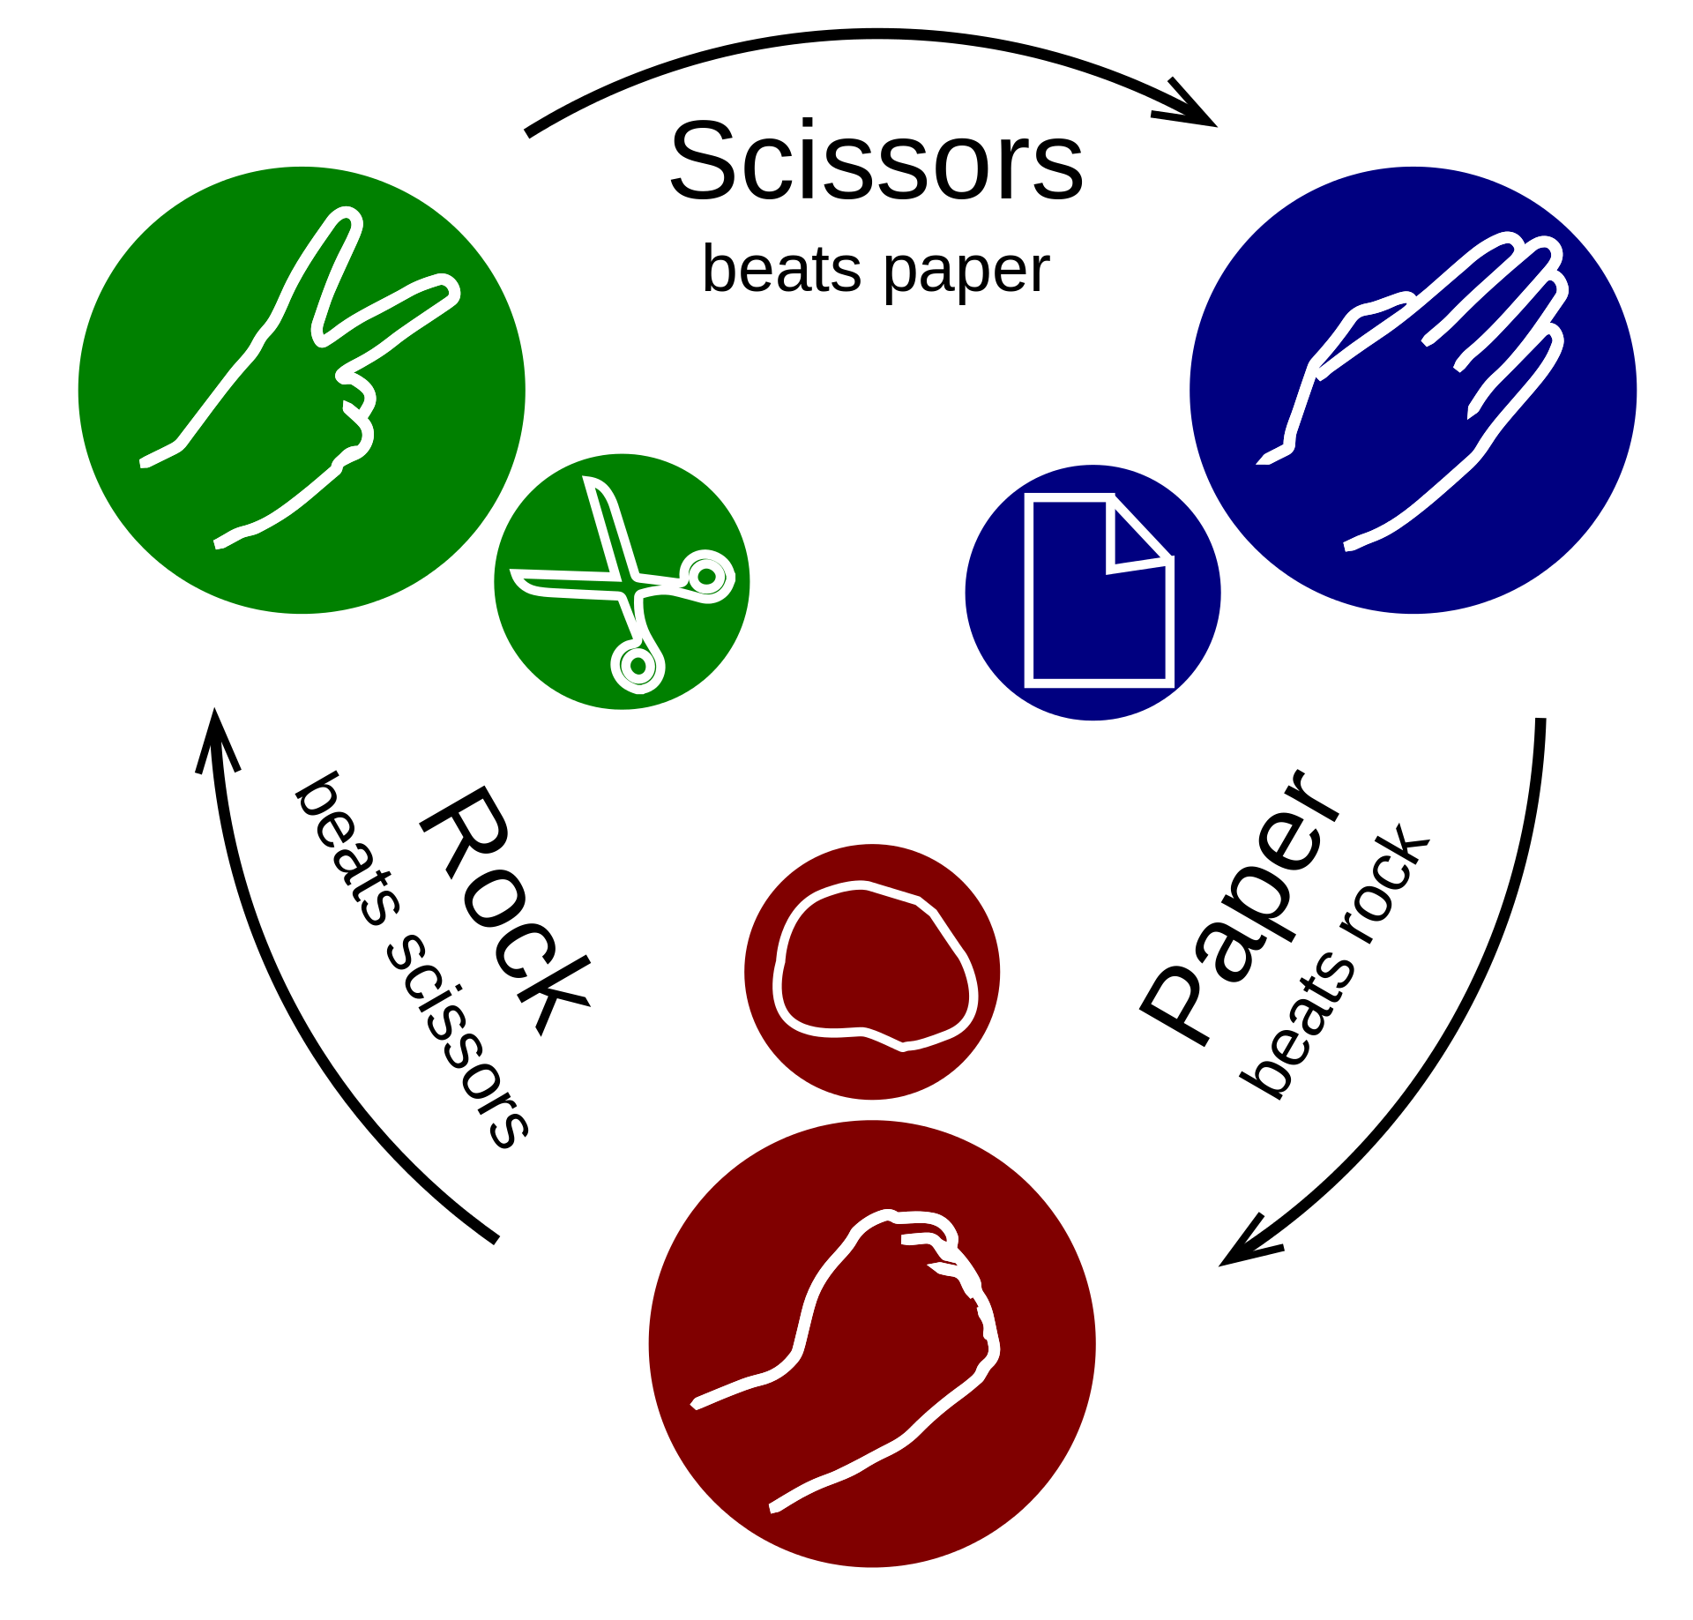

Slide 8
Game Theory
Four components: Rock paper scissors
Players—player 1 and player 2 (you and somebody else)
Strategies—each player can choose: Rock, paper, or scissors
Payoffs—players prefer winning to a tie, and prefer a tie to losing: win = 1, tie=0, lose=-1
Beliefs—what does each player believe about what object the other player will choose?
Notes:
Note: could have chosen other numbers. All that matters is win > tie > lose

Slide 9
Game Theory
Rock, Paper, Scissors payoff matrix:
Players choose at the same time. Player 1 is “row player” and Player 2 is “column player”. Player 1’s payoff goes first, by convention.
Player 2
 | Rock | Paper | Scissors
Rock | 0, 0 | -1, 1 | 1, -1
Paper | 1, -1 | 0, 0 | -1, 1
Scissors | -1, 1 | 1, -1 | 0, 0
Player 1

Slide 10
Nash Equilibrium
The key solution concept for game theory is called the Nash Equilibrium
The Nash equilibrium is a set of strategies (one for each player) such that no player wants to unilaterally switch to another strategy, given their beliefs about what the other players are playing.
“Given their beliefs…” is very important.

Slide 11
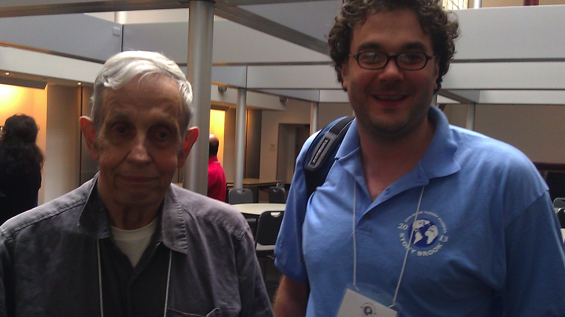
John Nash (and me) at the SBU Game Theory Festival 2013

Slide 12
Rock, paper, scissors: equilibrium
If I believe the other player will choose rock, then I should choose paper…
but if the other player believes I will choose paper, they would choose scissors…
but then I would no longer want to choose paper, I would choose rock…
but then they would choose paper…
but then I would choose scissors… but then they would choose rock...then we’re right back to where we started!
Rock, paper, scissors has no (pure) Nash Equilibrium…because there is no mutually stable set of strategies and beliefs.

Slide 13
Choosing a side of the road
Choosing which side of the road to drive on is a strategic situation
Most countries drive on the right; some on the left.
Sweden switched from driving on the left to driving on the right on September 3rd, 1967. See this short video here for an entertaining take on this event.
But what is the equilibrium?
First we have to define players, strategies, payoffs, and beliefs.

Slide 14
Driving: game theory
Players: driver 1 and driver 2
Strategies: drive on right; drive on left
Payoffs: if both players drive on same side, both players get 1; otherwise they get -100.
Beliefs: drivers believe other drivers will drive on the side that is legally required.

Slide 15
Driving payoff matrix
Players choose at the same time. Player 1 is “row player” and Player 2 is “column player”. Player 1’s payoff goes first, by convention.
Driver 2
 | Drive on right | Drive on left
Drive on right | 1, 1 | -100, 100
Drive on left | -100, -100 | 1, 1
Driver 1

Slide 16
Driving equilibrium
This is a coordination game—you want to do what the other player does.
If driver 1 believes that driver 2 will drive on the right side of the road, then she will also drive on the right side of the road. The same is true for driver 2.
So, the situation is stable—it’s an equilibrium!
If driver 1 believes that driver 2 will drive on the left side of the road, then he will also drive on the left side of the road. The same reasoning applies to driver 2.
So, this situation is stable too—it’s also an equilibrium!
So, (right, right) and (left, left) are both equilibria!
That is why there are examples of both across the world today, and why Sweden was able to switch with relatively few problems.

